Slide 1

DJJJ Presents
SEMS
Student Employee Management System
Dawson, Brown
Judah, Csanyi
Joshua, Leslie
Jeremy, Paruch

Slide 2
Meet
The
Team

Slide 3


Meet
The
Team
Primary: Programmer
Primary: Programmer
Primary: Programmer
Primary: Organizer
Dawson Brown
Judah Csanyi
Joshua Leslie
Jeremy Paruch
Secondary: Speaker
Secondary: Bug Catcher
Secondary: Bug Catcher & UML
Secondary: Bug Catcher & Programmer

Slide 4










Main Menu

Slide 5







How Its Made
How It’s Made

Slide 6
1

Slide 7
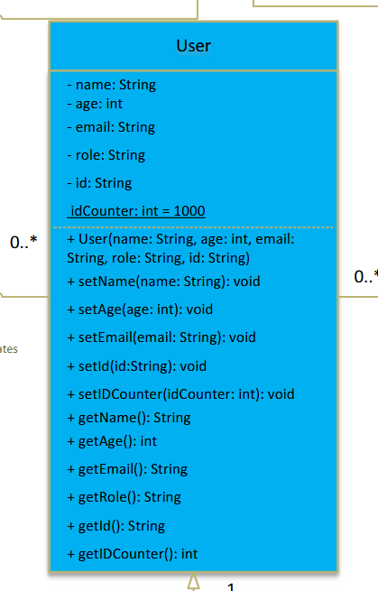
Super Class
1

Slide 8
2

Slide 9
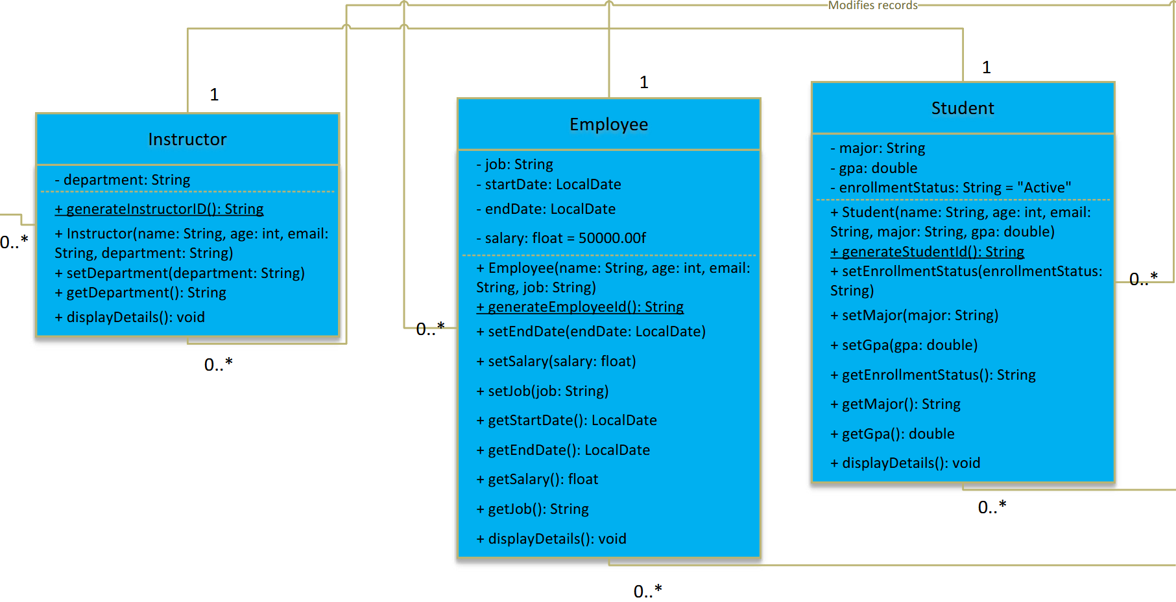
Sub Classes
2

Slide 10
3

Slide 11
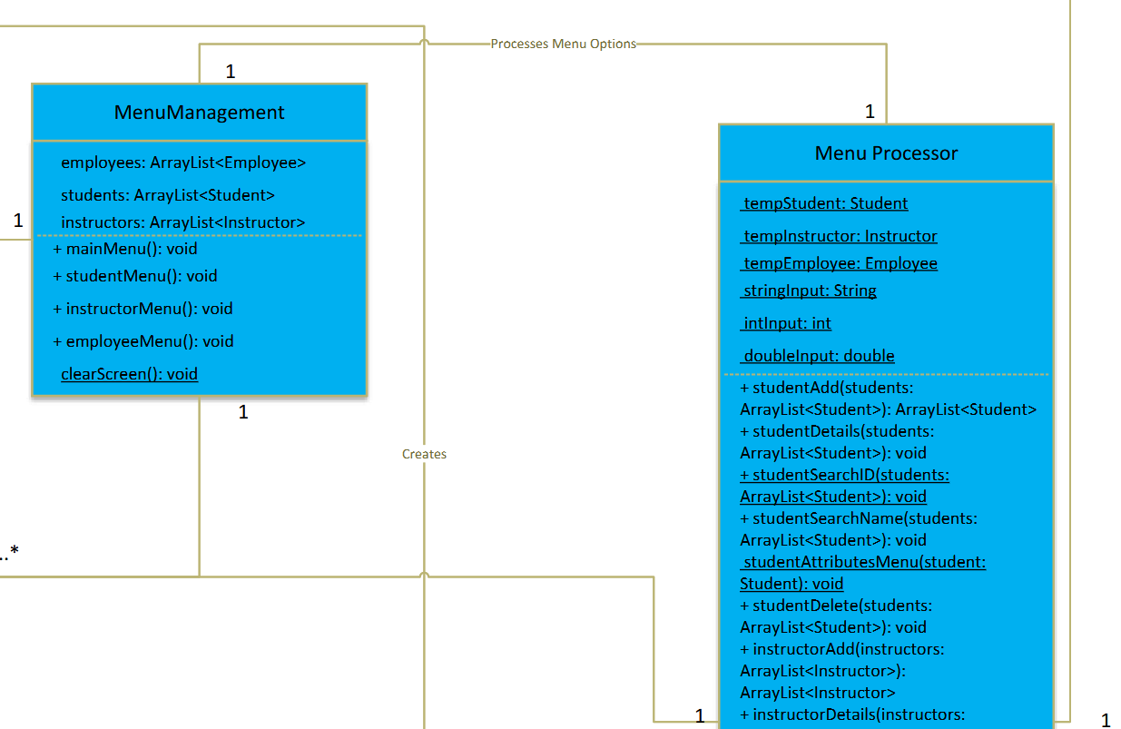
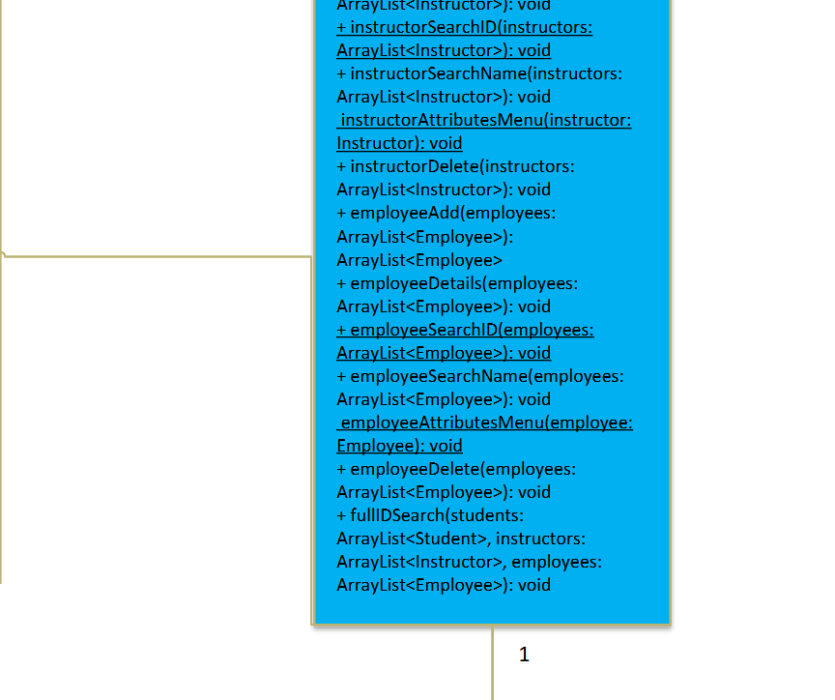
Menu Management
3

Slide 12
4

Slide 13
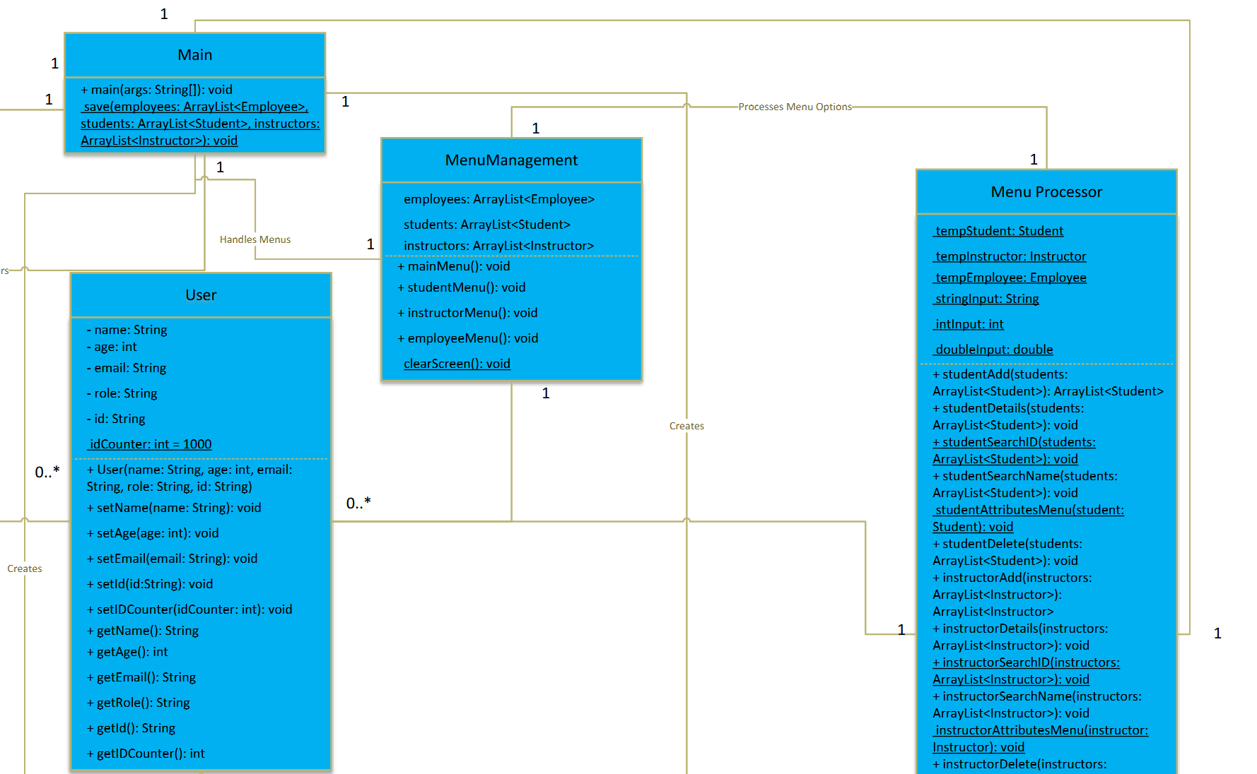
Main
4

Slide 14

Challenges
Challenges

Slide 15
1

Slide 16
Challenge
1
Managing saving to the file was hard and took a bit of time to figure out

Slide 17
2

Slide 18
Challenge
2
The inputs for the Instructor, Student, and Employee were all using the id counter from the User class,
they would be counting off each other rather than their own separate counter

Slide 19
3

Slide 20
Challenge
3
Making sure the id counters started at the last object created from the class was hard because
We had to scan the array list, take the last object in the array, and manually update the id counter when the program first runs

Slide 21
4

Slide 22
Challenge
4
Finding Bugs, a few mistakes here and there with Booleans

Slide 23

Solutions
Solutions

Slide 24
1

Slide 25
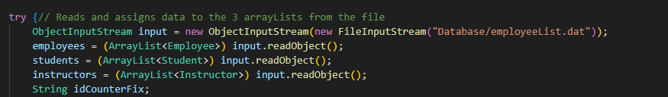
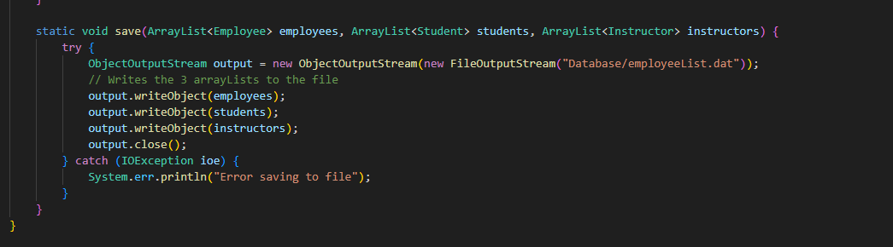
Solutions
1

Slide 26
2

Slide 27
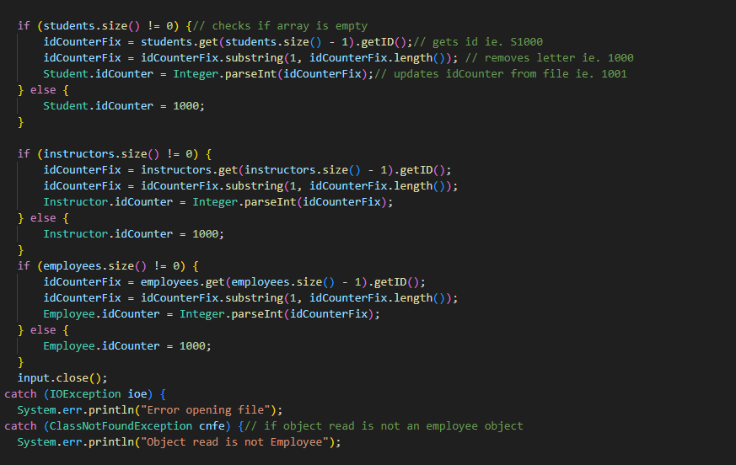
Solutions
2

Slide 28
3

Slide 29
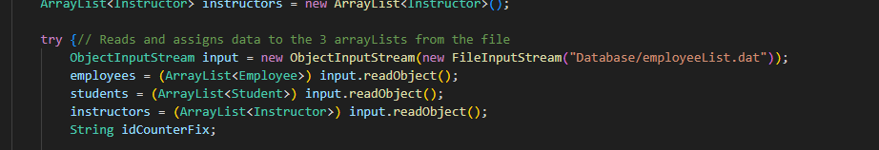
Solutions
3

Slide 30
4

Slide 31
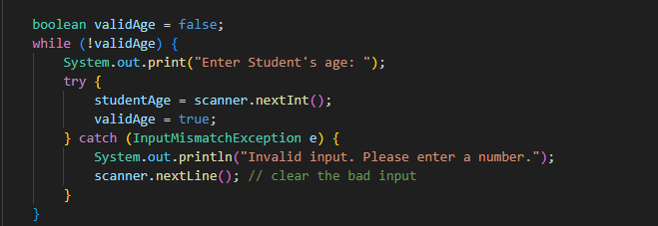
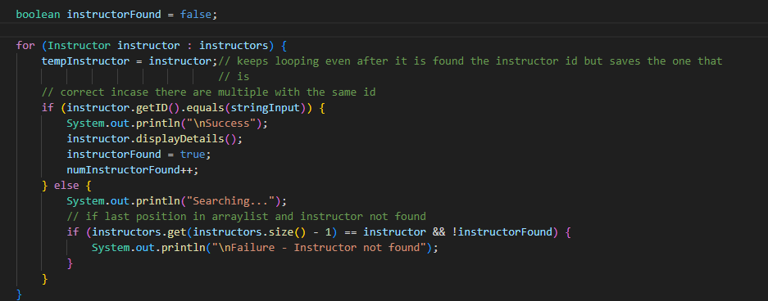
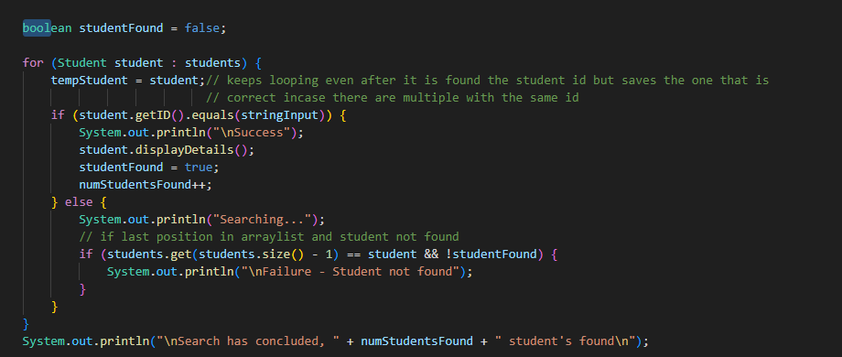
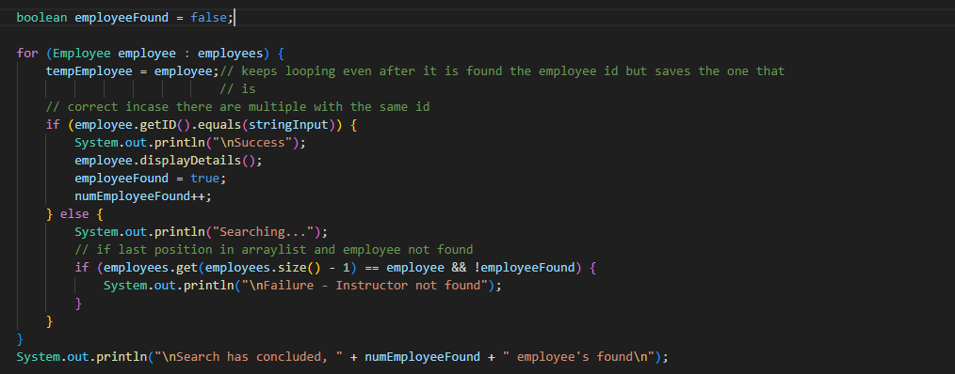
Solutions
4

Slide 32

The GUI
Coming SOON!

Slide 33

LIVE DEMO
Live Demo!

Slide 34

Going Forward
Going Forward

Slide 35

Closing Remarks
Thank you!

Slide 36

Questions

